Slide 1
Chapter 6:
Introduction to SQL
Modern Database Management
10th Edition
Jeffrey A. Hoffer, V. Ramesh,
Heikki Topi
© 2011 Pearson Education, Inc. Publishing as Prentice Hall

Slide 2
Objectives
Define terms
Interpret history and role of SQL
Define a database using SQL data definition language
Write single table queries using SQL
Establish referential integrity using SQL
Discuss SQL:1999 and SQL:200n standards

Slide 3
SQL Overview
Structured Query Language
The standard for relational database management systems (RDBMS)
RDBMS: A database management system that manages data as a collection of tables in which all relationships are represented by common values in related tables

Slide 4
History of SQL
1970–E. Codd develops relational database concept
1974-1979–System R with Sequel (later SQL) created at IBM Research Lab
1979–Oracle markets first relational DB with SQL
1986–ANSI SQL standard released
1989, 1992, 1999, 2003–Major ANSI standard updates
Current–SQL is supported by most major database vendors

Slide 5
Purpose of SQL Standard
Specify syntax/semantics for data definition and manipulation
Define data structures and basic operations
Enable portability of database definition and application modules
Specify minimal (level 1) and complete (level 2) standards
Allow for later growth/enhancement to standard

Slide 6
Benefits of a Standardized Relational Language
Reduced training costs
Productivity
Application portability
Application longevity
Reduced dependence on a single vendor
Cross-system communication

Slide 7
SQL Environment
Catalog
  A set of schemas that constitute the description of a database
Schema
  The structure that contains descriptions of objects created by a user (base tables, views, constraints)
Data Definition Language (DDL)
  Commands that define a database, including creating, altering, and dropping tables and establishing constraints
Data Manipulation Language (DML)
  Commands that maintain and query a database
Data Control Language (DCL)
  Commands that control a database, including administering privileges and committing data
Notes:
The system catalog consists of tables describing the structure of objects such as databases, base tables, views, and indices
Catalog -> describes the database
Schema -> describes objects created by user ( tables, views, constraints)
DDL – create, drop, alter
DML – changing data
DCL – privileges, security

Slide 8
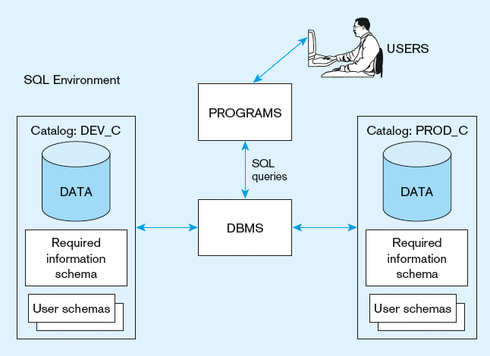
Figure 6-1
A simplified schematic of a typical SQL environment, as described by the SQL: 200n standard

Slide 9
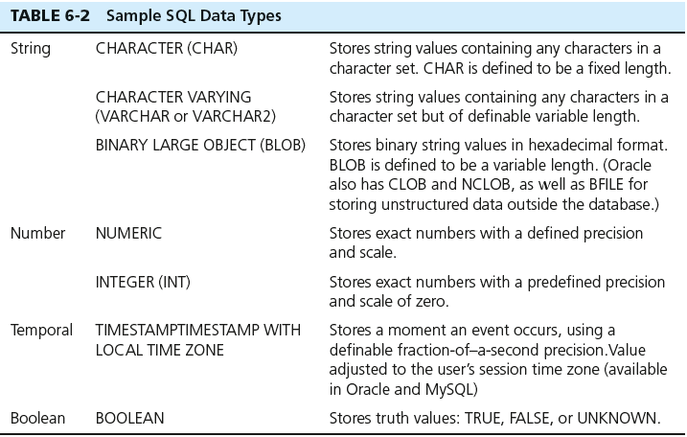
SQL Data Types

Slide 10
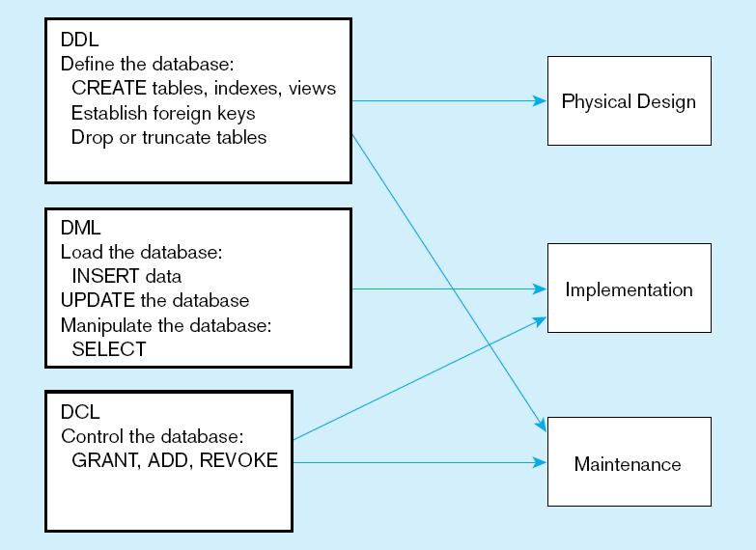
Figure 6-4
DDL, DML, DCL, and the database development process

Slide 11
SQL Database Definition
Data Definition Language (DDL)
Major CREATE statements:
  CREATE SCHEMA–defines a portion of the database owned by a particular user
  CREATE TABLE–defines a new table and its columns
  CREATE VIEW–defines a logical table from one or more tables or views
Other CREATE statements: CHARACTER SET, COLLATION, TRANSLATION, ASSERTION, DOMAIN
Notes:
CREATE SCHEMA
CREATE TABLE
CREATE VIEW
CREATE INDEX
CREATE STORED PROCEDUCTION
CREATE FUNCTION

Slide 12
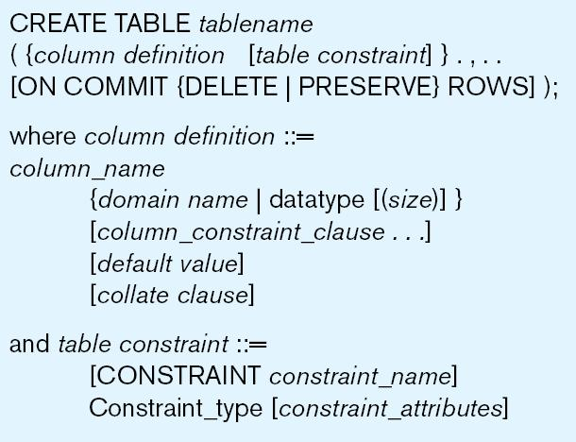
Table Creation
Steps in table creation:
Identify data types for attributes
Identify columns that can and cannot be null
Identify columns that must be unique (candidate keys)
Identify primary key–foreign key mates
Determine default values
Identify constraints on columns (domain specifications)
Create the table and associated indexes
Figure 6-5 General syntax for CREATE TABLE statement used in data definition language
Notes:
1 Identify data types for attributes – the name of each column, and their data types
2 Identify columns that can and cannot be null – optional
3 and 4. Candidate key, and primary keys
5 default values
6 Constraints
7 tables and constatrainsts

Slide 13
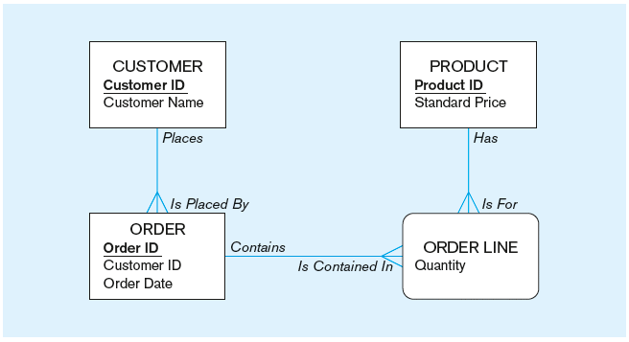
The following slides create tables for this enterprise data model
(from Chapter 1, Figure 1-3)

Slide 14
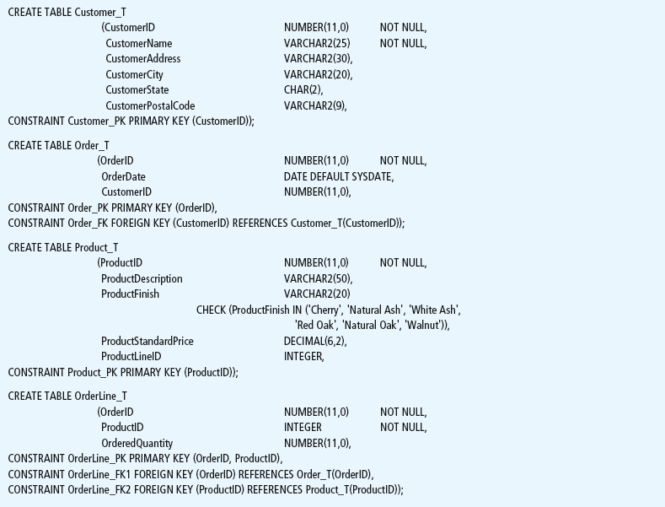
Figure 6-6 SQL database definition commands for Pine Valley Furniture Company (Oracle 11g)
Overall table definitions

